Slide 1

Slovak case
EU membership v Climate policy
Milan Zvara
Emission Trading Department
Directorate of Climate Change and Air Protection

Slide 2
Content
Differences in some obligations for a country in the EU and outside of the EU
The main advantages of the EU membership
Past 20 years in Slovakia
Details on ETS in Slovakia
Details on sectors outside of the ETS in Slovakia
Integrated National Energy and Climate Plan
Low Carbon Development Strategy up to 2050
Latest developments- EU level

Slide 3
Differences in some obligations for a country in the EU and outside of the EU
Reporting obligations
Number of meetings abroad

Slide 4
UNFCCC reporting obligations
National Inventory Report
Biennial reports
National Communications

Slide 5
EU reporting obligations
Annual report
National Inventory Report
Report on policies and measures and projections
Report on national adaption actions
Approximated greenhouse gas inventories
Report on the use of auctioning revenue and project credits
Report on financial and technology support provided to developing countries
Biennial reports and National Communications
Annual reporting about every type of fuel used and biofuels blended in the fuels
Report of compensation for the Indirect costs of EU Emissions Trading System in favour of sectors or subsectors exposed to a risk of carbon leakage
Numerous notification regarding any change to national allocation table (including aviation table) under ETS system and changes to international credit entitlement table
Notification regarding any changes to international credit entitlement table

Slide 6
UNFCCC meetings (annual)
Intersessional in Bonn
COP/MOP/MPA
Various other regional/international meetings

Slide 7
Meetings within the framework of the EU membership (annual)
4+2 Council of the Environmental Ministers
2 or more ECPG (Director Generals level)
10 WPIEI meetings (Head of Unit)+every day during the UNFCCC session
10 expert meetings (experts)
20-60 WPE meetings (climate attache based in Brussels+expert or HoU from capital)
Bilaterals, conferences, forums, workshops ...for EU member states

Slide 8
EU Presidency
Chapter itself.... Because you are chairing and coordinating many if not almost all of those previous meetings ☺

Slide 9
Biggest advantage of the EU membership (climate change area)
Europeanisation
EU Climate law
EU budget

Slide 10
Europeanisation
Importance and urgency of the topic – administration, business, young people
Synergies- inter-sectoral approach and solutions
Ambitions
Green transition as part of the solution not only short sighted business interests
Peer pressure of other MS
Exchange of information, best practices

Slide 11
Ambitions in Slovakia
We committed to Climate Neutrality by 2050 in June 2019
Phase out our coal-fired electricity production by 2023 and stopping all coal mining operations by 2027 (the region of Upper Nitra).
Already today 78% of our energy production is low carbon – essential to preserve technological neutrality (cannot raise ambitions without preserving nuclear energy). With phase out it will be 90% carbon free electricity production
Set national ETS target at the same level as the EU target (-43%)

Slide 12
Ambitions in Slovakia
We are ready to increase reduction commitments: from 40 to 45% EU emission reduction target by 2030 (by introduction of renewable sources and energy efficiency targets) and our national target from 12% to 20% decrease emissions from non-emission trading sectors.
Recently (Sept. 2019) Slovakia made a decision to allocate additional 2.5 billion euro for climate investments by 2030.
Internationally, Slovakia contributes to the Green Climate Fund (2 mil. USD this year).

Slide 13
2. Climate Law- Legal framework in Slovakia
Only 1 Slovak law (Emission Trading Act) and countless European laws:
ETS directive and aprx. 10 EU secondary acts regarding the ETS
Effort Sharing Decision/Regulation
LULUCF
CO2 standards on cars, vans and heavy duty vehicles
Energy law:
Renewable Energy directive and Energy efficiency Directive,
Energy performance standards of buildings
Many energy efficiency and ecological standards

Slide 14
3. Financing CC in Slovakia post 2020
1. Modernization Fund (ETS)- 1,3 billion euro
2. Environmental fund (Slovak ETS- auction revenues)- 1,2 billion
3. EU budget (25% goes to CC)- from 6 to 9 billion euro up to 2027. ( estimated- from 2021 until 2050 Slovakia could receive from 25 to 38 billion euro from EU budget only )
Other European funds- Switzerland and Norway
Innovation fund (ETS)- whole EU- 11 billion
Just Transition Mechanism- 100 billion euro for whole EU up to 2030
EIB will be transformed into Climate bank- 1 trillion euro for loans

Slide 15
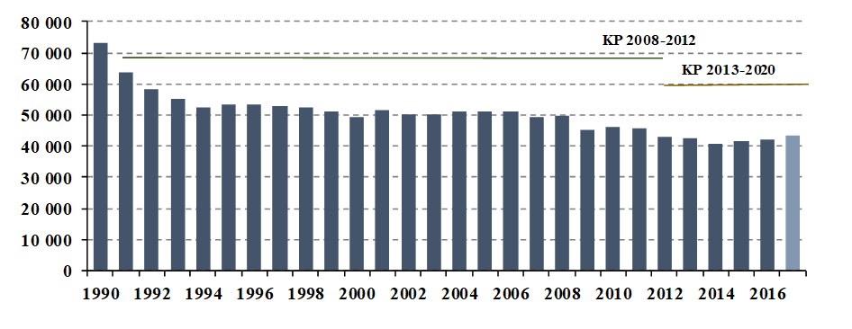
Past 20 years in Slovakia
Total GHG emissions were 43 316.45 Gg of CO2 eq. in 2017 (without LULUCF).This represents a reduction by 41% against the base year 1990.

Slide 16
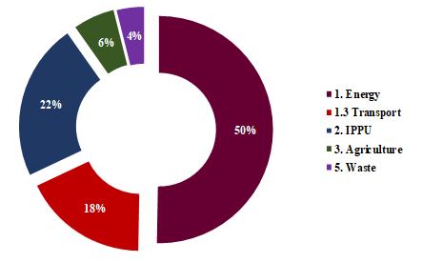
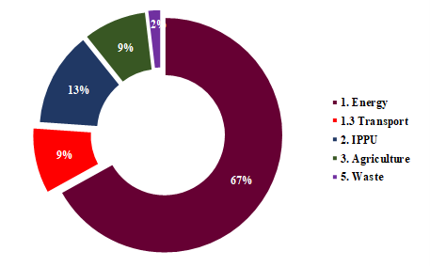
GHG Emissions by Sectors in 1990 and 2017
2017
1990

Slide 17
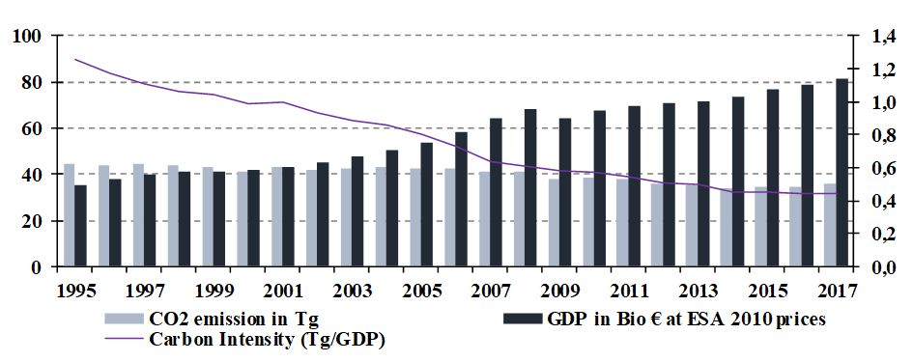
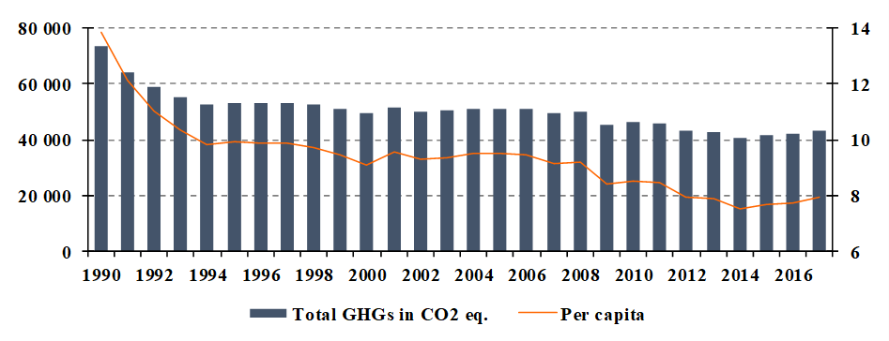
Comparison of CO2 emissions per GDP (carbon intensity)
Decrease of GHG emissions per capita: 1990 – 2017

Slide 18
Backbone of EU/Slovak climate change mitigation
EU ETS (ETS)
Non- ETS (ESD/ESR)

Slide 19
EU ETS Implementation in Slovakia
Act No. 414/2012 on emissions allowance trading
Several competent authorities (CA) with separate responsibilities:
Ministry of Environment – competent authorities with overall responsibility
Environmental District Offices - regional CAs with EU ETS specific responsibilities

Slide 20
Ministry of Environment
is the central government authority responsible for allowance trading,
performs primary state supervision of emissions trading matters,
prepares the list of installations and notifies it the Commission,
appoints the National Administrator (responsible for national account in the Registry),
notifies the amount of free allocation for operators,
submits reports to the Commission regarding emissions trading and the use of auctioning revenues,
operates the emissions trading reporting system,
aviation.

Slide 21
Environmental District Offices
A District Office is responsible for one district and has jurisdiction over installations that are established in their territory
issue permits to emit greenhouse gases,
approve of MPs,
change in permits and notification of changes of the MPs,
notify the Ministry of the issuing of permits, changes to permits and removal of an installation from the ETS,
receive and review AERs and VRs, confirm the correctness of the data contained,
carry out regional supervision of allowance trading within the district,
impose fines for infringements,
ETS inspections.

Slide 22
Organisational chart of EU ETS implementation in Slovakia
Competent Authorities
Ministry of Environment
Slovak National Accreditation Service
Environmental District
Offices
Slovak Environmental Inspectorate
Free allocation
General inspections
Application
Accreditation
Permit, MP
AER + VR
Aviation
Inspections
AER
Operators
AER + VR
Verifiers
MP = monitoring plans, AER = annual emission reports, VR = verification reports

Slide 23
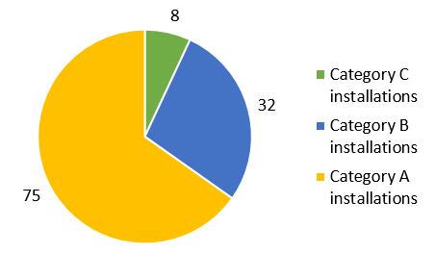
Number of installations in 2018 = 115
National allocation table 2013 - 2020
 | Allocated emissions | Verified emissions
2013 | 16 466 336 | 21 831 827
2014 | 15 820619 | 20 918 069
2015 | 15 029 434 | 21 181 216
2016 | 14 526 743 | 21 264 045
2017 | 13 849 714 | 22 063 225
2018 | 13 658 304 | 22 193 396
2019 | 13 251 549 | March 2020
2020 | January 2021 | March 2021
Auction
100 % auction revenue is an income of the Environmental Fund- but not everything used for CC
Increasing the energy efficiency of existing public buildings, including thermal insulation
Compensation for indirect emission costs (passed on in electricity prices)

Slide 24
Non- ETS sectors
Up to 2020 – Effort Sharing Decision (ESD)
From 2021 Effort Sharing Regulation (ESR)

Slide 25
ESD – Effort Sharing Decision
Sectors outside the EU ETS (households, small energy and industry, transport, waste and agriculture)
National Non-ETS target: +13 % (comp. 2005)

Slide 26
ESR from the Slovak perspective
-30% EU target (compared to 2005), sectors outside the EU ETS (households, small energy and industry, transport, waste and agriculture)
Target change from + 13% by 2020 to -12% by 2030 (compared to 2005), in 2019 we changed it to 20%
Emission adjustment in 2021 in accordance with Article 10 (1). 2 - an increase of 2 160 210 AEA
New flexibility with LULUCF - 1.2 mil. ton of CO2 eq.
SK is not entitled to one-off flexibility with ETS
Other flexibility:
- Borrowing 10% (2021-2025), 5% of allowances (2026-2030)
- Banking of surplus allowances to another year (2021-2029)
- Transfer of 5% (2021-2025), 10% (2026-2029) of allowances between Member States

Slide 27
Integrated National Energy and Climate Plan for 2021 - 2030
Governance for the Energy Union has stipulated this obligation
1st draft December 2018 with national contributions for EE and RES targets (binding targets – only EU level)
Summer 2019- Commission has adopted its recommendations
(Slovakia raise ambition for RES and EE)
11 December 2019 - Integrated National Energy and Climate Plan for the years 2021 to 2030 adopted by the government

Slide 28
EU and national targets (from the plan)
 | EU targets | National targets
GHG reduction target (1990) | at least - 40 % | at least - 40 %
ETS target (as of 2005) | - 43 % | - 43 %
Non-ETS target (as of 2005) | - 30 % | - 12 % (-20% )
Renewable energy target | 32 % | 19,2%
Energy efficiency target | 32,5 % | 30,3 %

Slide 29
Low Carbon Development Strategy up to 2050
Early Spring 2020- adoption of the Low Carbon Development Strategy up to 2050
Models show that with additional measures (more or less currently adopted national targets for RES and EE) will get us in 2050 only to -70% or max. 80% reduction which means emission gap from 23 till 14 MtCO2ekv.
Policy focus before 2030- renovation of the buildings, removal of the coal from the energy and industry sector, after 2030 electrification of transport and recuperation of the heat from industry
Increase of electricity consumption and new nuclear powerplant

Slide 30
Low Carbon Development Strategy up to 2050

Slide 31
Low Carbon Strategy up to 2050- cost of decarbonisation
-70 to 80 % target will cost additional 8 billion euro (2031-2050) and 196 billion euro (2031-2050) compared to reference scenario (BAU). In other words it will be annual additional cost on the level of 1,8 % GDP up to 2040 and 4,2 % GDP up to 2050
Savings- 2 billions on fuels
Households - additional 1 billion/annum before 2030 and 8 billions/annum in 2050
Higher GDP in the long term but lower household consumption, lower wages and higher unemployment

Slide 32
Latest developments- EU level
December 12- European Council (European Summit) committed EU to reach climate neutrality by 2050
New Commission – European Green Deal :
Reduction target for the EU will go from -40% to -50% or -55%
Changes in legislation such as
Transport and buildings part of the EU ETS
Carbon Border Tax for third countries according to carbon footprint of some products

Slide 33
Thank you for your attention
milan.zvara@enviro.gov.sk

