Slide 1
ILLEGAL MIGRATION ON THE TERRITORY OF THE SLOVAK REPUBLIC
RISKS ANALYSIS - ORGANIZATION AND METHODS ON THE NATIONAL LEVEL
Miroslav Hovancik
miroslav.hovancik@live.com
Skopje, 15 October 2018

Slide 2
DEVELOPMENT OF RISK ANALYSIS UNDER SCHENGEN ACQUIS
Schengen acquis established risk analysis as the corner-stone of the management of the external borders;
Schengen Borders Code is intended to improve the legislative part of the integrated border management;
Schengen Borders Code places risk analysis at the heart of border control;
Performance of risk analysis in the Member States is evaluated by the SCHEVAL as an individual component of the border management.
Notes:
The development of the Schengen acquis established risk analysis as the corner-stone of the management of the external borders. Schengen Borders Code (SBC) (Regulation 562/2006 of the European Parliament and of the Council of 15 March 2006 establishing a Community Code on the rules governing the movement of persons across borders) was intended to improve the legislative part of the integrated border management European Union policy by setting out the rules on the border control of persons crossing EU external borders and on the temporary reintroduction of border control at internal borders.
Schengen Borders Code, which sets the common rules for crossing the external borders, was issued three years after CIRAM was originally developed by the European Council Expert Group in 2003. Therefore, this circumstance created favourable pre-conditions to have the risk analysis firmly embedded in the Schengen Borders Code. Regulation 2016/399 of the European Parliament and of the Council of 9 March 2016 on a Union Code on the rules governing the movement of persons across borders (Schengen Borders Code) is also highlighting the role of risk analysis.
Consequently, the Schengen Borders Code places risk analysis at the heart of border controls by defining border controls as comprising not only checks on persons at border crossing points and surveillance between these border crossing points, but also an analysis of the risks for internal security and an analysis of the threats that may affect the security of external borders. This sets the end goal of risk analysis, which is to guarantee internal security and the security of external borders.
Member States should also have the possibility of temporarily reintroducing border control at internal borders in the event of a serious threat to their public policy or internal security. In this context the role of risk analysis is utmost important as well.
Equally important is the mention in the Schengen Borders Code of avoiding excessive waiting time at border crossing points. This widens the objective of the management of the external borders to include the management of bona fide border crossings. For this purpose, the high standards of risk analysis are necessary in order to provide border guards, primarily performing the first line border checks, with necessary knowledge and skills in order to enable them to single out potential offenders for the second line border checks thus assuring smooth and fast border check for bona fide passengers.
It is important to note in the context of the link between risk analysis and Schengen Borders Code, that performance of risk analysis in the Member States is evaluated by the SCHEVAL as an individual component of the border management.

Slide 3
Definition – What stands CIRAM for ?
Common
Integrated
Risk
Threat and Risk analysis
Analysis
Model
Risk Analysis
By FX
For FX, MS
Several inputs –> one output
conceptual
framework

Slide 4
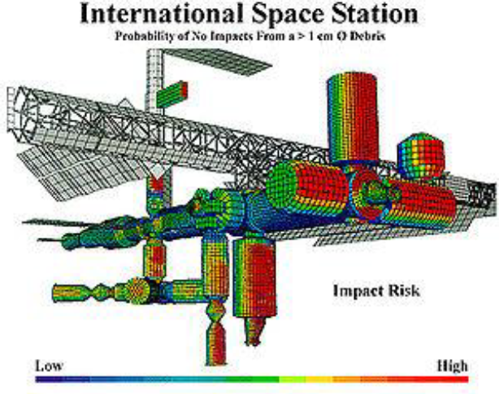
RISK

Slide 5
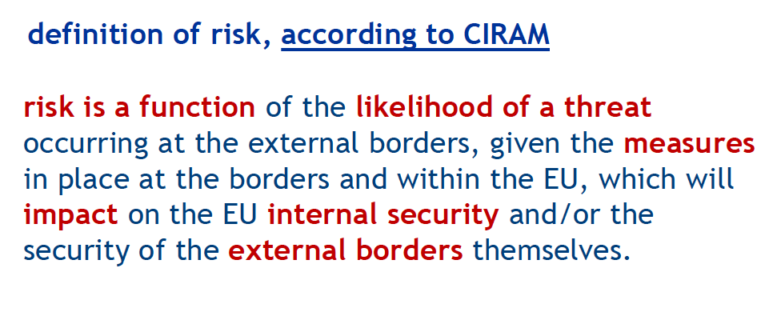
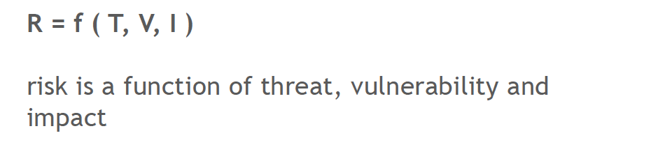
COMMON INTEGRATED RISK ANALYSIS MODEL

Slide 6
Example : RISK (general)
Threat = rain (likely, shower)
Vulnerability = no umbrella
Impact = get wet
Risk = It is likely to rain, without having umbrella, you might/will get wet.

Slide 7
Diagram: Main components of CIRAM
Intelligence cycle
RISK
Threat
Vulnerability
Impact
1. Magnitude &
2. Likelihood
3. Level of vulnerability
(EU, MS of entry/destination)
4. Level of Impact

Slide 8
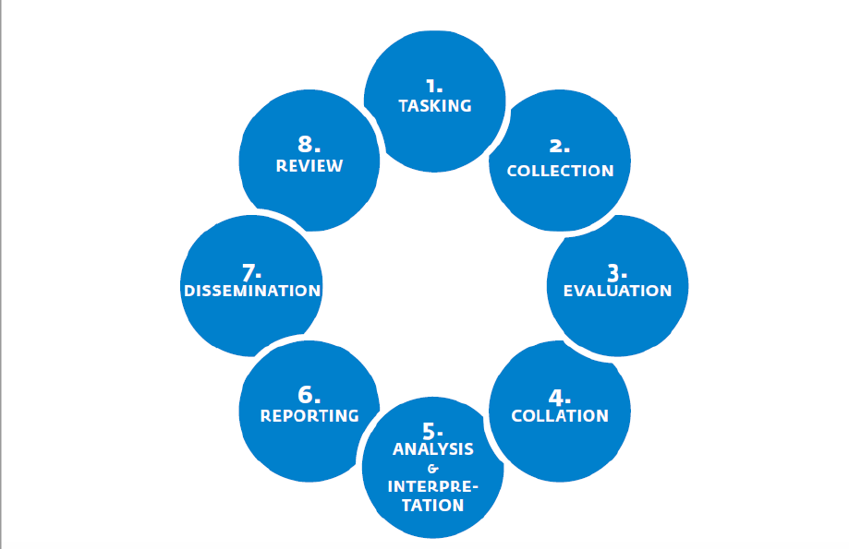
Intelligence cycle

Slide 9
Complete Diagram of CIRAM
RISK
Threat
Vulnerability
Impact
1. Magnitude &
2. Likelihood
3. Level of vulnerability
(EU, MS of entry/destination)
4. Level of Impact
Modus operandi of travel, crossing, avoiding detection, documents
Border permeability (Terrain, infrastructure, capabilities, flows)
Border and Internal security
Who, where, when
Operational activities (staff, training, interoperability)
Ability to manage legitimate passenger flow at border
Trends and predictions (Increase, decrease, stable, historical)
Legal response
Humanitarian impact
Push factors (Civil unrest, unemployment, local policies, environment)
Pull factors (diasporas, employment opportunities, social systems)
Routes (difficulty and distance), access to facilitation

Slide 10
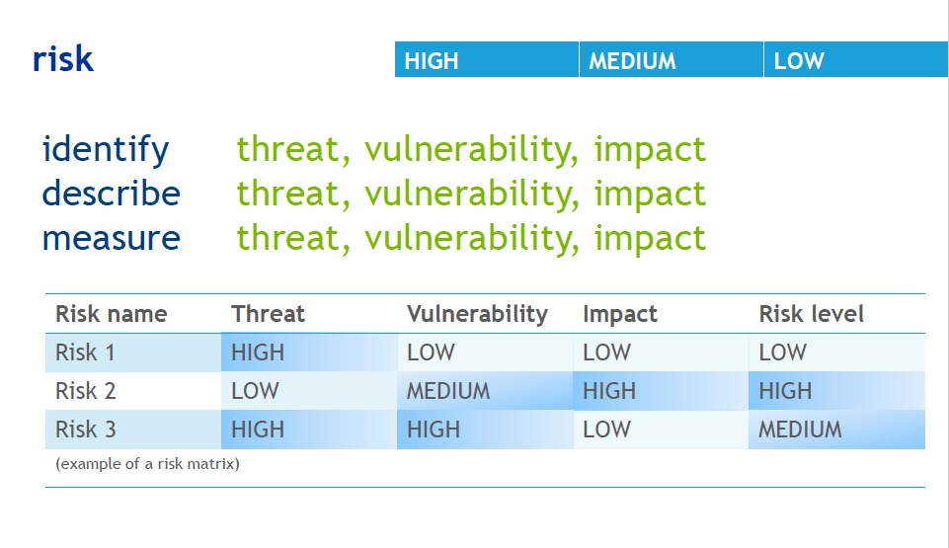
COMMON INTEGRATED RISK ANALYSIS MODEL

Slide 11
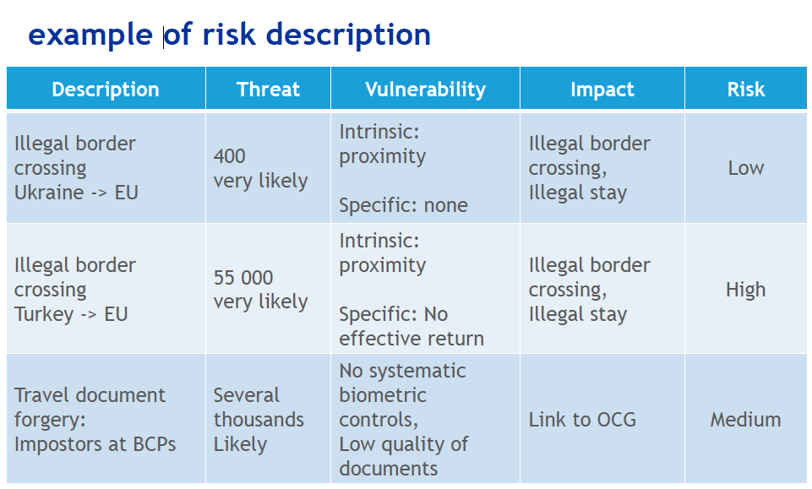
COMMON INTEGRATED RISK ANALYSIS MODEL

Slide 12
ORGANISATIONAL CHART
MINISTRY OF INTERIOR
Direct command
Economically independent
Financially independent
PRESIDIUM OF POLICE FORCE
Vice-prezident
BUREAU OF BORDER AND FOREIGN POLICE
Notes:
Bureau of Border and Foreign Police of the Presidium of Police Force was established on 1 April 2000 as the body with a nationwide scope for the quality control of borders of the Slovak Republic. There is the external land border with Ukraine of 97.8 kilometres and the external air borders on the three so-called Schengen airports in Bratislava, Košice and Poprad since the Slovak Republic entered into the Schengen area.
BBFP is a department of the Presidium of the Police Force, which directly manages, guides and controls the activity of its organizational units in the performance of tasks in the field of:
Border control and border surveillance
Fight against illegal migration and trafficking in human beings,
Risk analysis,
Cooperation with the European Agency for Border and Coast Guard (hereinafter referred to as "Frontex")
Analysis of travel documents,
Residence regime for foreigners,
Returns of foreigners,
Expulsions of foreigners,
Visa issues, and
to a limited extent at the section of asylum procedures and implementation of the Dublin Regulation.

Slide 13
RISK ANALYSIS
Organizational chart
Central level
Bureau of border and FOREIGN police
RISK ANALYSIS
AND COORDINATION DEPARTMENT
ADMINISTRATIVE
AND INTERNAL
DEPARTMENT
DEPARTMENT OF
INTERNATIONAL COOPERATION
BORDER POLICE
DEPARTMENT
FOREIGN POLICE DEPARTMENT
ECONOMICAL DEPARTMENT
NATIONAL UNIT FOR COMBATING ILLEGAL MIGRATION
External
border
Control AND FRONTEX UNIt
COORDATION
UNIT
analysis and statistics
UNIT
FOREIGNER‘S MATTERS
UNIT
COORDINATION OF DATA PROCESSING
UNIT
CENTRAL VISA AUTHORITY
UNIT
OPERATIVE-SEARCH
AND IVESTIGATION
ACTIVITIES
UNIT
WEST
Travel
Document
analysis
UNIT
OPERATIVE-SEARCH
AND INVESTIGATION
ACTIVITIES
UNIT
CENTRAL
DBAP
BRATISLAVA
DAP
BANSKÁ BYSTRICA
DBAP
PREŠOV
DBP
SOBRANCE
PDCA
MEDVEĎOV
PDCA
SEČOVCE
Regional level
OPERATIVE–SEARCH
AND INVESTIGATION
ACTIVITIES
UNIT
EAST

Slide 14
RISK ANALYSIS Organisation
Central level
RISK ANALYSIS AND COORDINATION DEPARTMENT of Bureau of Border and Foreign Police
Regional level
ANALYSIS AND STATISTICS UNITS of Directorates of Border and Foreign Police
Local level
BASIC UNITS OF BORDER AND FOREIGNPOLICE in field
Notes:
According to CIRAM, risk analysis is carried out on three levels:
centrally at the RISK ANALYSIS AND COORDINATION DEPARTMENT of the Bureau of Border and Alien Police,
at the regional level at the Directoriates of border and alien police in Bratislava, Banská Bystrica, Prešov and Sobrance,
and at the local level, at the basic units of the border and alien police (with competence at external borders and inland).
At the central level, analytical products are being developed to strategically analyze risks. The Strategic Risk Analysis provides information that is the basis for strategic action with implications for the entire SR and the Schengen area, the creation of long-term visions for the future, the preparation of budgetary measures for the next year and the legislative activity. The Central Unit also provides and organizes the collection, flow and processing of data, information and statistics on illegal and legal migration.
At the regional level, analytical products focusing on operational risk analysis are being developed, combining qualitative and quantitative information with the operating environment, identifying risks, assessing vulnerabilities (focusing on the search for borderline and internal security gaps). Based on this, short-term visions are devised, they set firm roles and competencies in order to increase the quality of the local and regional level of activities. Operational Risk Analysis is also one of the essential resources for creating a strategic risk analysis.
At the local level, analytical products of operational and tactical risk analysis are developed to provide relevant information for the real-time profiling of real-time tasks, evaluate the internal situation with a focus on searching for gaps (the vulnerability of the border control and internal security management system), revealing of modus operandi of illegal or pseudo-legal migration. Strategic and operational risk analysis can be affected in the case of the failure at the local level.

Slide 15
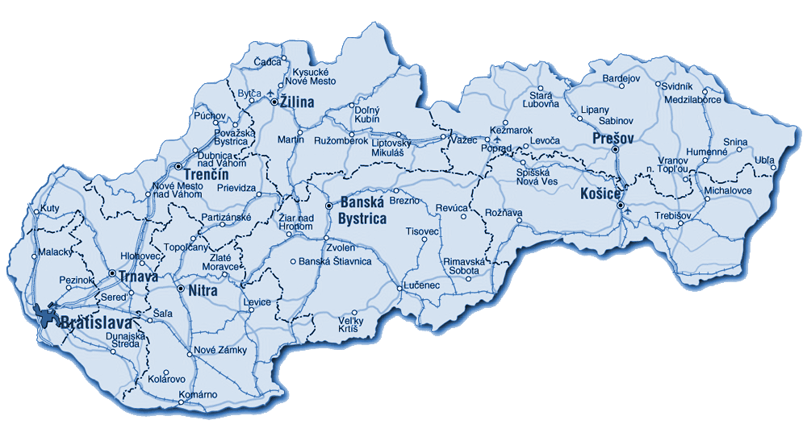
REGIONAL UNITS
Regional level
DAP Banská Bystrica
DBAP Prešov
DBP Sobrance
DBAP Bratislava
Alien Police Unit
Border Control Unit (BCU)
Border Control Unit – Airport
Police Detention Centre for Foreigners
Asylum Unit
Local level

Slide 16
LEGAL BASIS
Instruction
of the Bureau of Border and Foreign Police
no. 3 of 9 January 2018,
to ensure a common procedure for risk analysis within the competence of the Bureau of Border and Foreign Police of the Presidium of the Police Force
Order
of the Director of the Bureau of Border and Foreign Police
no. 8 of 31 January 2018,
imposing tasks for ensuring a common procedure for risk analysis within the competence of the Bureau of Border and Foreign Police of the Presidium of the Police Force
Notes:
Instruction of the Bureau – came in force 15 january 2018
In accordance with Regulation (EU) 2016/1624 on Frontex Agency, the Risk Analysis is implemented through the implementation of the Common Integrated Model of Risk Analysis Version 2.0 - "CIRAM").
CIRAM is translated in the Annexes as the Guidance for Risk Analysis Departments - The structure and tools for the CIRAM application are listed in annexes as well.
Order of the director – came in force on 31 january 2018
By order, tasks are assigned in the appendix to the superiors, analysts and other police officers specified in the Instruction of the Bureau nr. 3/2018 to ensure a common approach to risk analysis within the competence of the Bureau
determination of the responsibilities of superiors in the process of risk analysis and in the process of application of analytical products in the management activity are assigned as well. There is also listed the role of the analyst at the individual levels of management to ensure a common approach to risk analysis within the competence of the Bureau.

Slide 17
risk analysis
Risk analysis and statistics unit
coordination of data procesing unit
Establishment of the Risk Analysis and coordination department
FROM 2010 - launch of IS MIGRA:
evidence for the cases of aliens organized chronologically according to their solution
integration of terminals AFIS, EURODAC and INTERPOL AFIS
individual identification of persons based on fingerprints
common system for illegal migration and international protection
Analysis
Bi - monthly
Bi - annual
Annual
Tailored
Notes:
In terms of periodicity, regular and irregular analytical products are processed. Regular analytical products include annual risk analysis, bi-annual risk analysis and bi-monthly analytical report, at regional level, bi-annual risk analysis and monthly risk analysis are developed, and quarterly risk analysis and monthly analytical report at local level. Irregular analytical products (tailored risk analysis, tailored analytical report, informative report, profile report, analytical alert, target entity profile) are processed at all levels, based on a request from a superior or other organizational unit of the Bureau of Border and Alien Police, or based on its own findings of an analyst.
All analytical products are distributed both horizontally and vertically to provide feedback and continuity in the exchange of information. Centrally processed analytical products are also available to all police officers for all three levels of management through the intranet site of the Bureau of Border and Alien Police. Analytical products at the regional level are made available on the intranet site of each directorates of the border and alien police. These products are sent electronically to basic border and alien police units in field, providing ongoing access to analytical products and up-to-date information on illegal migration to all police officers within the border and alien police. In addition, all analytical products are distributed to other Directorates and to the central level through the Fabasoft Registry System, which has been deployed since 2018 within all departments of the Border and Alien Police.

Slide 18
Risk analysis
Organization of information flow
Central
Operations
Centre
Bureau of Border and Foreign Police
IS Migra IS ECU CQC
Risk Analysis
and Coordination
Department
National Unit
for Fight against
Illegal Migration
Coordination
Unit
Operations Centre
Sobrance
Regional Directorates
Unit for Operative Activities and Investigation
Coordination,
Risk Analysis and Statistics Unit
Executive departments
Shift leaders
Police officer authorized
to perform risk analysis
Analysis and information
Situation reports of COC
Situation reports of OC Sobrance
Event reports
Notes:
The baseline information flow is within the reporting service. The nature of the reporting service consists of processing event reports processed by all executive departments of Border and Alien Police.
The organizational units of the Border and Alien Police (except of DBP Sobrance) report the event to the Central Operations Center and at the same time to the local Operations Center of the Police District Directorate. The organizational units of the DBP Sobrance report the occurrence of events to Operations Center Sobrance as well as the other individual organizational units of the Border and Alien Police if they occur in the regional district of DBP Sobrance. Operations Center Sobrance will evaluate the event, take action, and complete the event as necessary.
The reported events are processed in daily situational reports. Daily situational reports are used for managing and organizing officials at all levels. Within the reporting service, the Central Operations Center acts as a Distributor and Incident Processor at the central level. Through the established approaches, the Migration Situational Image (it is the Annex of the Situation Report) is published directly on the Intranet site of the Border and Alien Police, which is operated by the Department of Analysis and Coordination. This ensures the flow of information from the central level to the regional and local levels.

Slide 19
IS MIGRA – scheme of working procedure
Query according to fingerprints
negative
Creation of a new person – fingerprings/document
negative
Alfanumerical query
affirmative
affirmative
Subject card (identities, documents, photos...)
Details of Procedures MÚ
Details of Procedures BaFP
Create a new action
Create a new procedure
Establisment /choosing of a group
Details of action
Details of action
Notes:
In order to improve the flow of information, a new Migration and International Protection Information System (MIGRA) was developed. It was launched in 2010. The MIGRA information system allows the recording of cases related to illegal migration and international protection in a progressive hierarchy of services. Its integration into AFIS, EURODAC and INTERPOL AFIS simultaneously ensures clear identification of people based on dactyloscopic fingerprints. This functionality is very important in view of the attempts of some illegal migrants to hide their true identity. On April 20, 2016, a screening according to the dactyloscopic fingerprints in INTERPOL AFIS was implemented in the IS MIGRA. In this regard, the Slovak Republic has begun to systematically screen all illegal migrants detected to eliminate the risks of terrorists or other serious offenders. The information system MIGRA is a primary source of information on illegal migration on the territory of the Slovak Republic, which is used in the production of statistical outputs as well as in the production of analytical products. The information is regularly inserted into the IS MIGRA directly by the executive departments of the Border and Alien Police. Checks on the data input are three-step and take place at local, regional and then centrally on a daily basis. Control of data at the local level is carried out by the heads of the executive departments and control at the regional and central level by the risk analysis units. This measure almost eliminated the error rate, and at the same time created a natural pressure on analysts to get familiar with the current situational picture. At the same time, it is worthy to add that in the IS MIGRA there is a much wider range of information than the reporting service and IS is user friendly (search, sorting and summarizing information according to different criteria is comprehensible and clear) and it is made accessible to border and alien police officers on all three levels of management. Access to IS MIGRA is also available to other police services, which is very desirable due to the redistribution of tasks in inland inspections.
AFIS - National automatic fingerprint identification system

Slide 20






IS MIGRA – mutual communication with other information systems of the Ministry of Interior
INBO
SIS
alphanumeric data
Article 24
CLK
MIGRA
fingerprints
data
CLKm
INTERPOL
Article 24
AFIS
EURODAC
Notes:
Another important source of information is CLK (Central screening console). It provides information on the hits made in the national and international screening information systems (persons, things, motor vehicles) and information on entries and exits of third-country nationals at the external borders.
Information on legal flows of passengers, apprehended irregular documents, security-repressive actions and other activities of the executive departments of Border and Alien Police are collected and recorded in the database "Selected statistical information and data". This data collection system has been in place to ensure the collection of information and data that do not contain the above mentioned information systems. The collection takes place from the local level to the regional and national ones and the outputs from the database are processed and made available on the intranet site of Border and Alien Police for all police officers at local, regional and central level in an expanded form with the option of selecting the necessary indicators and the specified period.

Slide 21
Risk analysis
The main sources of information
Non – departmental authorities
RISK ANALYSIS
Non – governmental organizations
Other
sources
Information systems
(IS Migra)
Departments and Units of the Bureau of Border and Aliens Police
Joint
contact
points
Other
Police Services of the Police Force
Police
attachés
abroad
RISK ANALYSIS
International Police Cooperation
(Frontex, Interpol, Europol)
Notes:
For regional risk analysis information and analysis of events at the local level are used. Knowledge of regional level risk analysis is passed on to both local and central level to ensure feedback and continuity in the exchange of information. The Central Unit (Risk Analysis and coordination department) also provides and organizes the collection, flow and processing of data, information and statistics on illegal and legal migration. The main sources are IS MIGRA, IS ECU (evidence of aliens with legal stay) and CLK. In addition to analytical products which are uploaded on the intranet site of Border and Alien Police, there are regular and irregular statistics on legal and illegal migration, analytical products processed by Frontex, information from police deputies, information on the new modus operandi and the phenomenon of illegal migration sent by other authorities at national or international level (embasiees and general consulates of the SR abroad, analytical departments of neighboring Member States). Nevertheless improvements are expected in particular in the quality of interviews with illegal migrants, information inserted in information systems, case reports on illegal migration, and risk analysis training from regional to local level.

Slide 22

STATISTICS REGARDING ILLEGAL MIGRATION ON THE TERRITORY OF THE SLOVAK REPUBLIC
Notes:
- Doplniť obsah

Slide 23
ilLegal migration
Notes:
The number of illegal migrants for 2017 was the highest since the SR's entry into Schengen. Unlike in 2015 (partly in 2016), when Slovakia was marginally affected by the migration crisis, which resulted as a transit migration mainly from the territory of Hungary along the Western Balkan route, the development of illegal migration on the territory of Slovakia in 2017 was influenced mostly by the illegal migration of nationals from the nearest third countries - Ukraine and Serbia. The number of Serbs and especially Ukrainians increased significantly and together made up for almost 75% of total illegal migration in the SR in 2017. Due to the visa liberalization and the current conditions on the Slovak labor market, it is assumed that their number will continue to increase.
The IS increase is related to the increasing number of apprehensions inland and also at the BCPs at the exit from SR. This increase is recorded mostly due to an increasing number of Ukrainian nationals. Ukrainians can be characterized as typical overstayers, since they enter the Schengen legally and consequently violate the conditions of stay, especially in relation to period of stay. The most frequent reason for overstayerhood is to carry out work.
The high number of apprehended Ukrainians inland is a result of the execution of security-repressive actions for combating illegal work. These actions have resulted in the detection of illegal work or several cases having signs of illegal work. Apart from Ukrainians, in particular Serbs, Macedonians and Bosna and Herzegovina nationals were detained as well. Foreigners are often unaware of the violation of the conditions, as they are not aware of the obligations under applicable laws and regulations.
In the category of IBC, there was a decrease in cases at the BCPs. Nevertheless, the trend of submitting false and forged documents at the BCPs, which is especially perpetrated by Ukrainians, continues to be recorded. On the contrary, in 2017 there has been recorded an increase on the green border (from 124 to 205). The largest share of the increase was the detention of five large groups of Vietnamese. The Vietnamese in 2017 account for up to 62% of the overall IBC at the green border. Similarly to past years, the modus operandi of the IBC was crossing the green border on foot without identity papers and with the help of facilitators. Given the current opportunities for relatively low-cost transport, the availability of information and communication technologies that provide current information for migrants, it is cheaper, faster and, above all, safer to enter the Schengen pseudo-legally with overstaying for illegal migrants coming from the former Soviet republics and Asia.

Slide 24
ILLEGAL MIGRATION - TOP 5 NATIONALITIES
Notes:
This chart describes TOP 5 nationalities shares of overall illegal migration numbers in compare with the previous 5 years. Ukrainians are long-term first ranking nationality in terms of illegal migration on the territory of Slovak Republic and their share (together with Serbs) of overall illegal migration rises continuously. The share of nationalities associated with transit migration has declined sharply as you can see on the AFG, IRQ and SYR nationals.

Slide 25
TRANSIT MIGRATION
in compare with OTHER INDICATORS – ON monthly BASIS
Notes:
In 2017, the most significant decrease in illegal migration was recorded at the illegal entry into the SR from Hungary. However, the border section with Hungary continues to be the dominant place of migrants' entry into our territory after illegal entry into the Schengen area and subsequently after illegal entry into the Slovak Republic. The target countries for migrants in 2017 were in particular Germany (147), Slovakia (38) and Austria (17). In terms of nationality, IRQ (98), AFG (25), SYR (17) and VNM (17) represented the largest share of nationals who were apprehended on the territory of the SR. Significant declines occurred in AFG and SYR nationals compared to 2015 (AFG 99, SYR 350) and 2016 (AFG 112, SYR 67).
Based on evidence collected, interviews carried out and statements of migrants apprehended in the territory of the Slovak Republic, the most frequent destination country is Germany, followed by Austria and Sweden. There were also migrants, who stated a Western Europe as their destination. Based on accepted Dublin returns, we can also state, that destination countries for these migrants were Germany, Austria and Sweden.

Slide 26
Asylum seekers of illegal migration
Notes:
Slovakia is known as a Member state with very strict asylum policy. As there were also many cases of no shows in reception centers in the past, Slovakia had adopted a legislation change, and since 1.1.2014, asylum seekers may be detained for the period of asylum procedure, if there is grounded suspicion they will abuse the asylum application just to avoid their return to the third country and continue to intended destination country.
In the last year, decreasing number of asylum application was being recorded. Once, applicants were registered and placed to facilities for asylum seekers, many of them have left the facility and continued their journey to destination countries.
These facts have led to the fact, that only those migrants, who are interested in applying for asylum in Slovakia and intend to stay on the territory of Slovak Republic, apply for international protection in Slovakia.

Slide 27
Return decisions and effective returns
27
Notes:
In recent years there has been recorded an increase in the number of return decisions and effective returns, which is related to an increase in total illegal migration. In 2017, the overall increase in the number of return decisions was attributable to an increase in the number of removals to a third country (especially to Ukraine, which is related to an increase in the number of apprehended Ukrainians whose illegal stay was detected at the BCPs on exit from the Slovak Republic). The difference between the number of issued return decisions and effective returns is mostly affected by the fact that some foreigners have been issued with an obligation to leave the territory of the Slovak Republic within the stipulated period, but the fulfillment of the obligation can not be detected due to the absence of internal border checks (this problem shall be partially resolved with introduction of the entry/exit system at the external borders).

Slide 28
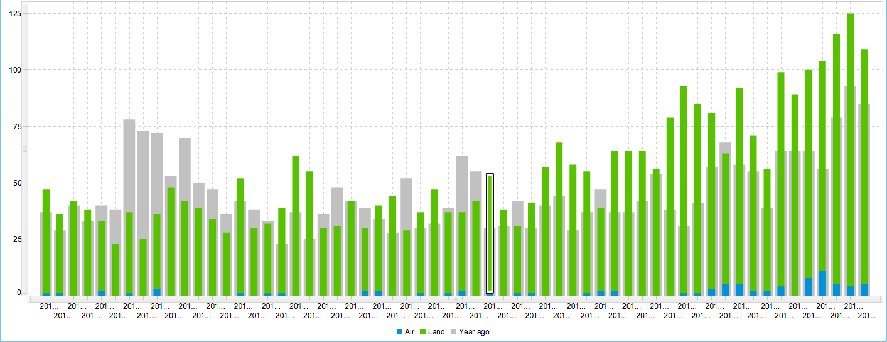
Refusals of entry
2013 - 2017
Notes:
The increase in the number of refusals of entry in the last 2 years (2016-2017) was mainly related to an increase in the number of third-country nationals entering the Slovak Republic legally (by 143 000, + 22.4%) and to visa liberalization.
With regard to visa liberalization, the number of refusals of entry of Ukrainians increased significantly according to the letter "F" (the length of his stay in EU Member States has already reached 90 days during the previous 180-day period) and according the letter "H1" (person for whom an alert has been issued in the SIS for the purposes of refusing entry). An increase in this indicator was apparently also influenced by the significant increase in entry bans recorded into the SIS by other MS. This is confirmed by the fact that Ukrainians, who have been once expelled from the Schengen area and are still not allowed to enter the Schengen area, have nevertheless attempted to enter the Schengen area with new biometric passports.
Total increase of the refusals of entry was also caused by the refusals of Ukrainians according to the letter “C” (has no valid visa or residence permit). Starting in 2016 this was not connected with the intention to enter Slovakia, but included the obligation of Ukrainian owners of vehicles registered in the EU to meet the Ukrainian legislative and to leave the territory of Ukraine with the vehicle every five days. In addition, the entry was also refused to Ukrainians who did not have a valid visa or residence permit and presented a passport without biometrics.
The significant increase in the number of refusals of entry at the air border was related with regular flights from the former Yugoslavia - mainly from Macedonia and Serbia. This was reflected in the composition of nationalities. Most often, the entry was refused to Serbians, Macedonians and Albanians according to the letters "F" (the length of his stay in the EU Member States has already reached 90 days during the previous 180-day period) and "H1" (person for whom an alert has been issued in the SIS for the purposes of refusing entry). Flights from Niš and from Skopje to Bratislava were introduced in 2016. The most refusals of entry (62 out of 65) were issued at the Bratislava airport, which has the largest volume of flights from third countries. The other three cases were at the Košice airport. In the case of the introduction of planned flights - in particular the Tbilisi route - a further increase in the number of refusals may occur in 2018.

Slide 29
Refusals of entry – TOP NATIONALITIES
2013 - 2017
84,6 %
93,8 %
91,1 %
94,2 %
91,3 %
Notes:
Ukrainians represents huge share on the total number of refusals of entry. The highest number of refusals of entry is in the long term according to the letter "C" - person does not have a valid visa or residence permit; the second most frequent reason is the refusal of entry according to the letter "F" - the length of stay in the territory of the EU Member States has already reached 90 days during the previous 180 days.
The significant increase in 2016 of the refusals of entry of UKR nationals was mainly related to an increase in the number of passenger flow on entry into the Slovak Republic. Another reason for the increase was the introduction of special follow-up inspections at the land border. These were aimed at checking the authenticity and validity of documents, entry stamps and the correct marking of travel documents. The identified gaps served to take further measures to prevent and eliminate them. The increase in the number of refusals of entries was also significantly contributed by Ukrainian vehicle owners with foreign registration numbers (as I mentioned before).
At the air border, the most refusals of entry were recorded on scheduled flights from the former Yugoslavia, mainly from the Niš to Bratislava and from Skopje to Bratislava. Both flights were introduced as early as 2016.

Slide 30
REFUSALS OF ENTRY TO UKR NATIONALS WITH BIOMETRIC TRAVEL DOCUMENTS
Notes:
As you can see in the chart describing refusals of entry to UKR nationals with biometric passports, almost all have been refused to enter the SR according to the letters “F” and “H1”.

Slide 31
SOME SELECTED STATISTICS
 |  | 2012 | 2013 | 2014 | 2015 | 2016 | 2017
Refusals of entry | land border | 607 | 441 | 512 | 477 | 761 | 1 052
 | air border | 7 | 8 | 5 | 9 | 8 | 65
Number of asylum aplications |  | 730 | 441 | 328 | 330 | 146 | 166
Readmission | Persons handed over (from SR) | 111 | 152 | 162 | 454 | 121 | 188
 | Persons taken over (to SR) | 28 | 29 | 58 | 410 | 16 | 28
Dublin transfers | Persons handed over (from SR) | 13 | 43 | 45 | 348 | 83 | 32
 | Persons taken over (to SR) | 151 | 144 | 98 | 64 | 27 | 23
Notes:
Comparing years 2016 and 2017, despite the annual increase in the number of total illegal migration by almost 25 %, the number of filed asylum applications is the same as in 2015, when a significant annual decrease was recorded. This decline is directly related to the nature of illegal migration as well as to the fact that the Slovak Republic is not primarily the target country of asylum seekers due to a strict asylum policy and a lower level of social and financial benefits compared to the preferred target countries (Western Europe, Scandinavia).
In the category of readmission, we can see an increase in 2017 in comparison with 2016, when a significant decrease was recorded after the record year 2015. The increased number of persons handed over from the territory of the Slovak Republic in 2017 was caused mainly by the rise of IBCs of the green border related to the apprehension of large groups of Vietnamese. Most people were returned to Ukraine in 2017 (up to 98% of the total number of readmissions from the territory of the Slovak Republic), which involved migrants who illegally crossed the state border to Slovakia from Ukraine. Most take overs were from the Czech Republic, Austria and Poland.
The number of persons handed over and taken over in the category of Dublin transfers decreased in 2016, and this trend continued in 2017, reflecting the gradual decline in illegal migration on the eastern Mediterranean route and then on the Western Balkan route. In 2015 there was a change in the trend in this area where the number of persons taken over was higher than the number of persons handed over from the SR. By 2015, the Slovak Republic was the recipient country in particular. In 2015 and 2016, most of the persons handed over from the SR were foreigners who arrived in Slovakia via the Western Balkan migration route. Thus, most of the Dublin transfers were made to Hungary in 2015 (335), to Hungary and Bulgaria in 2016 (equally for 31 persons) and to Bulgaria and Romania in 2017 (equally for 8 people).

Slide 32
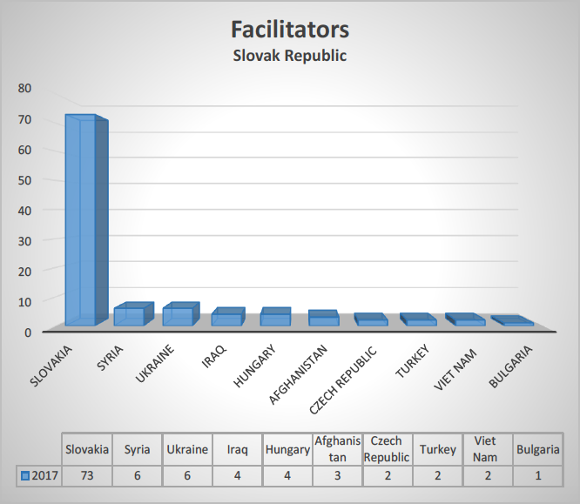
OVERALL NUMBER OF FACILITATORS AND THEIR NATIONALITY
IN 2017

Slide 33
FACILITATION ALONG SVK-UKR BORDER
Total number of illegal green border crossings:
Nationality of migrants apprehended with facilitators:
Notes:
In 2017, 6 cases were recorded at the state border compared with 6 cases in 2016. In these 6 cases, 8 persons were detained (4 SVK, 4 UKR) who attempted to transfer over 86 people (64 VNM, 11 IND, 6 BGD, 5 LKA).
1. The BCU in Topoľa (April 2017) detained one UKR national, which facilitated to cross the green border to 4 people (3 VNM, 1 IND).
2. The BCU in Vyšné Nemecké (June 2017) detained one SVK person, which helped to cross the external border from the UKR into the territory of the SR to 8 VNM.
3. Patrols of the MIU of Sobrance in cooperation with the patrol of BCU in Ubľa (June 2017) detained 3 UKR nationals who transferred 11 people (6 BGD, 5 LKA) to our territory.
4. The case of an illegal crossing of the state border by air transport was recorded in the territory of the Slovak Republic, thus infringing the rules on international flights. In this case, illegal migrants were transported by unconfirmed aircraft to the territory of the Slovak Republic. In the evening, this aircraft landed at a small airport near the Slovak-Ukrainian border. Pilot after unloading illegal migrants flew back to Ukraine. In this way, 10 illegal migrants of Indian nationality were transferred to the territory of the Slovak Republic.
5. The BCU in Podhoroď (August 2017) detained one SVK, who transferred 25 VNM persons on the loading part of the lorry further into the inland of the SR.
6. The patrol of the MIU (August 2017) detained 2 SVKs who loaded a total of 28 VNMs in passenger cars. They attempted to move from the border area to the inland as well.
In 2017 there was a similar modus operandi on the Slovak-Ukrainian border as in previous years. Despite the relatively stable situation and despite the slight decrease in cases of cross-border crime at the external Schengen border, in 2017 there was a slight increase in cases of trafficking with modus operandi on foot and then, after crossing the state border, with the help of motor vehicle transporters, further into the inland. In these cases, the main nationality of the transffered illegal migrants was Vietnamese, whose number grew in comparison with 2016. In the case of documented cases of trafficking, 222 illegal migrants, mainly from the Russian Federation (93), Vietnam (82), Syria (24) and other countries mainly from Asia, were transferred across the Slovak-Ukrainian border in 2017.

Slide 34
illegal migration on the territory of the SR
January 2017 - September 2018

Slide 35
MEASURES AT THE EXTERNAL BORDER FOR THE FOLLOWING PERIOD
Border surveillance measures
strengthen the border patrols in the critical times
closer cooperation between neighbouring patrols and with UKR border guard
more carefull and quicker operative physical checks in the case of signals from technical means
more carefull control of the persons inland in the border vicinity
more attention to the smuggling along the rivers
Border checks measures
more carefull profiling of persons
performing second-line checks
starting to build entry-exit system
ABC gates at the Bratislava Airport
Notes:
Border surveillance measures
1. Overlapping the border guard with a two-member patrol equipped with off-road vehicle in the border sections considering the terrain, night vision and thermal camera at night, every day of the week. Command the patrol with the service dog to every night on each BCU PF.
2. Closer cooperation between the patrols of neighbouring BCU, MIU PF and District departments of the Police Force, and gain knowledge and information from the Border guard Service of Ukraine.
3. During surveillance, provide observations in critical places, especially during night and early morning hours, with the use of night vision devices, and immediately find the necessary precautions when detecting relevant facts concerning illegal border crossing.
4. According to reports, it is necessary to carry out physical checks of signals from technical means, with the maximum utilization of the assigned service technique, in order to shorten the time from signing up to physical examination of the given section.
5. In the control of inland people: emphasize verbal communication and focus attention to travel documents that entitle foreigners to stay in the territory of the Slovak Republic.
6. Pay increased attention to the movement of persons from the inland of the SR to the green border that may attempt to cross the green border in order to avoid border control, thereby revealing the failure to fulfill the conditions of stay in the Schengen area.
7. Pay increased attention to border rivers, due to possible sudden and heavy rainfall, which can contribute to increase levels of border rivers and hence possible smuggling of smuggled goods along these rivers.
8. Continue with the intensive exchange of information on the green border illegal crossings with the Ukrainian border guard, and focus on taking measures under the joint patrols to prevent cases of illegal migration from the UA to the SR.
9. In order to eliminate the risk of smuggling goods along the border rivers (Uh, Latorica, Tisa), continue to carry out irregular inspections of riversides with a focus on revealing sites for picking up smuggled goods from the river.
10. Regularly carry out co-operative actions with Customs officers focusing on detecting the presence of illegal migrants and smuggled goods (checks on persons, goods, baggage, operating and cargo space of trains, as well as space control of passenger trains).
Border checks measures
1. At the border check constantly carry out a careful profiling of persons, especially with focus to the residence permits, visas and crossing stamps (especially Polish and Slovak).
2. Regarding the control of means of transport, continue to pay attention to vehicles of lucrative brand names that need to be checked in available information systems and records.
3. Focus on possible hidden places in both the passenger cars and the lorries and also in the trains.
4. Perform special second-line checks to check the authenticity and validity of travel documents and crossing stamps for third-country nationals.
5. Regularly familiarize yourself with the received information and follow the page of the Alien and Border Police concerning new ways of counterfeiting.

Slide 36
OVERALL SUMMARIZATION
Abusing asylum procedure remains still significant way for staying in countries of the European Union (secondary migration/movement) or to avoid the return procedures.
Misuse of Schengen visas issued by other Schengen states, especially misuse of Polish visas.
Regarding the document fraud an increasing number of forged border crossing stamps are expected related to Ukrainian nationals.
The intra Schengen flights from Greece and flights from Turkey will be still affected by using forged EU travel documents.
The situation concerning with the visa liberalization needs continuous attention especially the UKR, GEO, MDA, SRB, ALB categories.
Regarding the UKR nationals an increasing number of refusal of entries can be expected.
The number of overstayers (mainly UKR and SRB interested in carrying out work) which entered the Schengen area legally but they do not meet the conditions of stay or visa conditions is expected to grow.
Fast international exchange of information has positive impact on importance of implementing effective measures and helps coordinate common approach.
Importance of international police cooperation is growing in the light of effective fight against illegal migration.

Slide 37
THANK YOU FOR YOUR ATTENTION!

